Slide 1

Web Scraping To Gain Company Insights
Jagan Saravana
11/08/2024

Slide 2
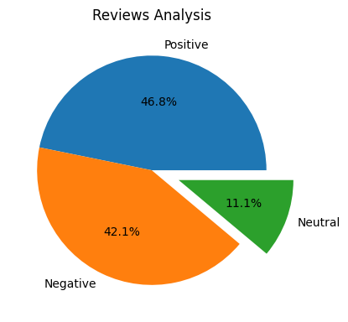
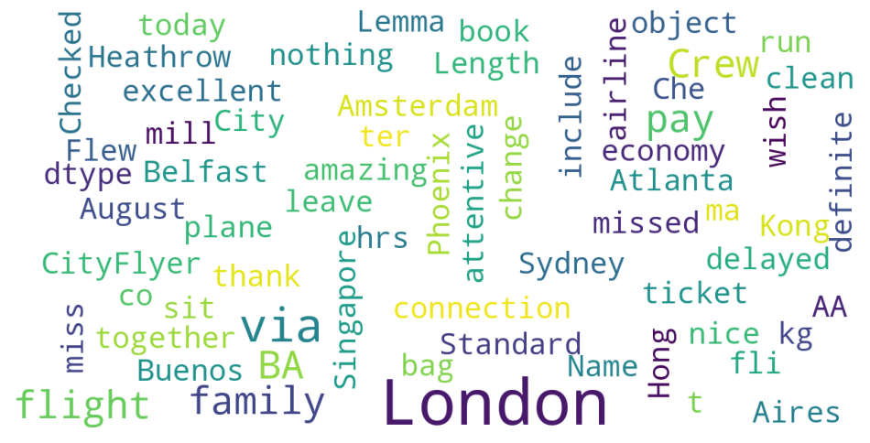
INSIGHTS FROM CUSTOMER REVIEW
From Cleaning 1000 Reviews Given by The Customers, We Obtained
Positive Reviews – 468
Negative Reviews – 421
Neutral Reviews – 111
Word Cloud of Keywords used in reviews

